Slide 1
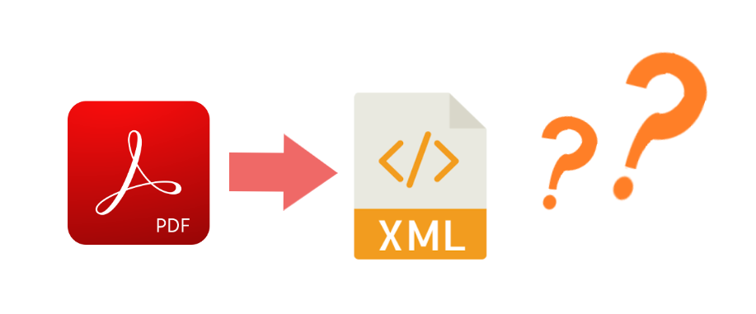
Index Extraction From Textbooks
KOM Lab Design Workshop – Group KM-2
Yujin Wang Ruolin Huang Fabian Rösch
guantao0815@gmail.com hrl96fz@foxmail.com fabianroesch@gmail.com Tim Steuer

Slide 2
Our Project: Index Extraction From Textbooks
Motivation
Index of a book can contain information about its contents that can be analyzed
If Index can be extracted it can be used for keyword extraction or algorithmic paragraph headline creation
Problem
Most Textbooks are PDF
PDF is not well structured and thus can not easily be interpreted by a machine
Idea
It’s difficult for a machine to read and contextualize the content of a PDF file
XML is well structured with labels
Solution
Automate index extraction from PDF files to standardized XML files

Slide 3
Existing Related Projects and Services
Amazon Textract | AWS cloud based service to extract data from scanned documents using machine learning made for scanned documents that do not contain actual text expensive and not open source
Apache Tika | Java based toolkit to parse PDF Documents and it‘s metadata and extract into HTML format extraction powerful
PDFBox | Open Source Java Library powerful well documented and integrated

Slide 4
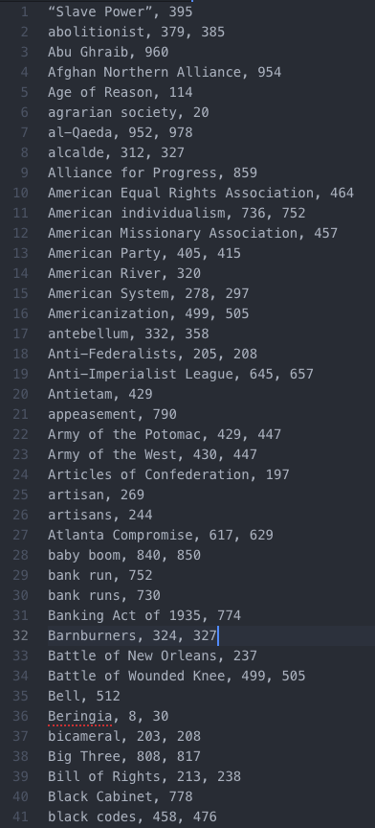
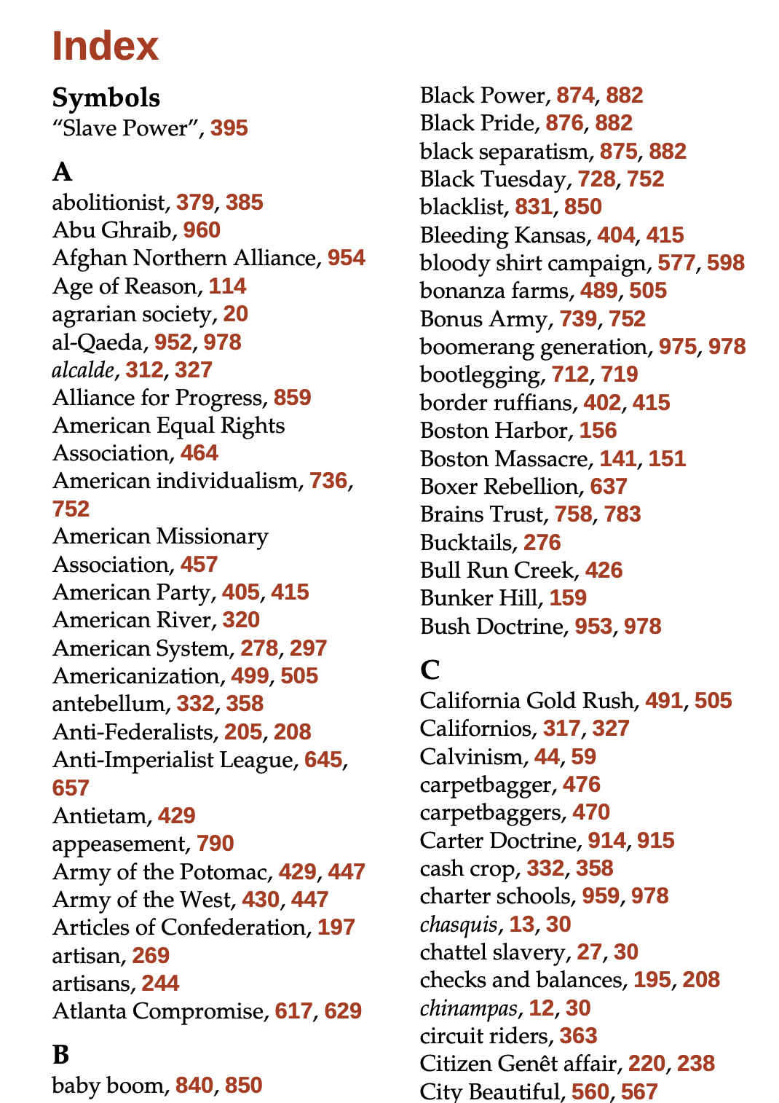
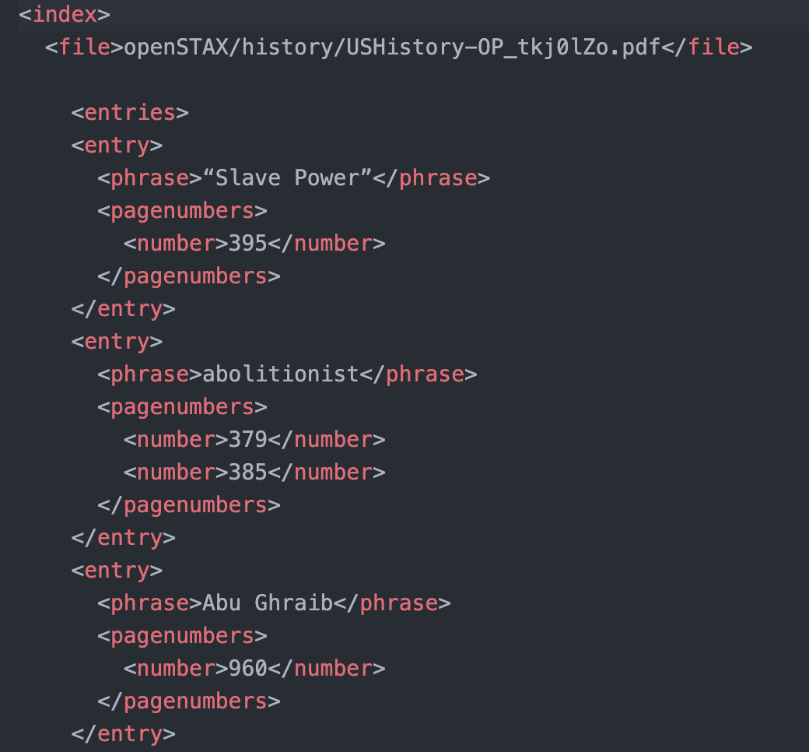
Implementation Idea: Intermediate Format
Step 1
Step 2
U. S. History [1]
Notes:
Intermediate Format to easier work with in java → String

Slide 5
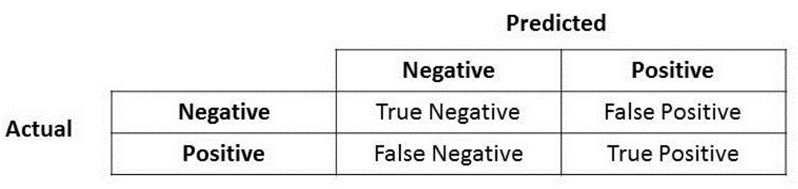
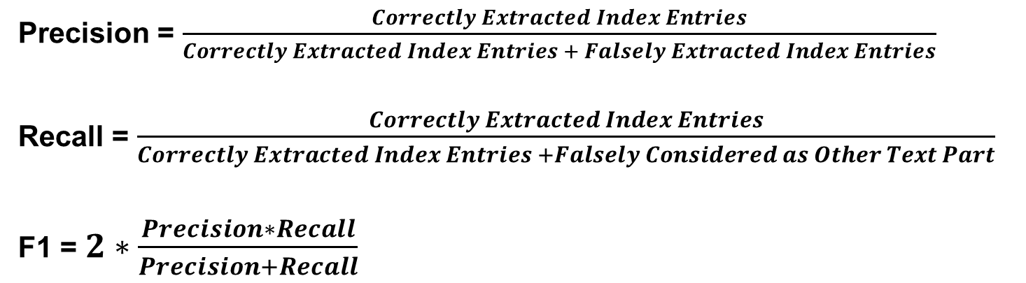
Evaluation Method: Precision, Recall and F1 Metric
Precision = $\frac{Correctly Extracted Index Entries}{Correctly Extracted Index Entries + Falsely Extracted Index Entries}$
Recall = $\frac{Correctly Extracted Index Entries}{Correctly Extracted Index Entries +Falsely Considered as Other Text Part}$
F1 = $2∗\frac{Precision∗Recall}{Precision+Recall}$
Accuracy, Precision, Recall or F1?[2]
Notes:
Intermediate Format to easier work with in java → String

Slide 6
Status Quo
Golden Standard
Five manually created sample XML files for verification and testing
Programming language and library
Java
PDFBox library
Raw text extraction
Raw PDF to TXT extraction including all undesired content
Basic filtering of undesired content and separating phrases from page numbers
Performs well in one PDF but it still need to be optimized for general using
Notes:
Java for ease of use and most experience in team
Pdfbox because of extraction method in easier to work with txt format
Golden standard for testing and determining accuracy
First steps are to extract the index with all undesired conctents and then filter that out

Slide 7
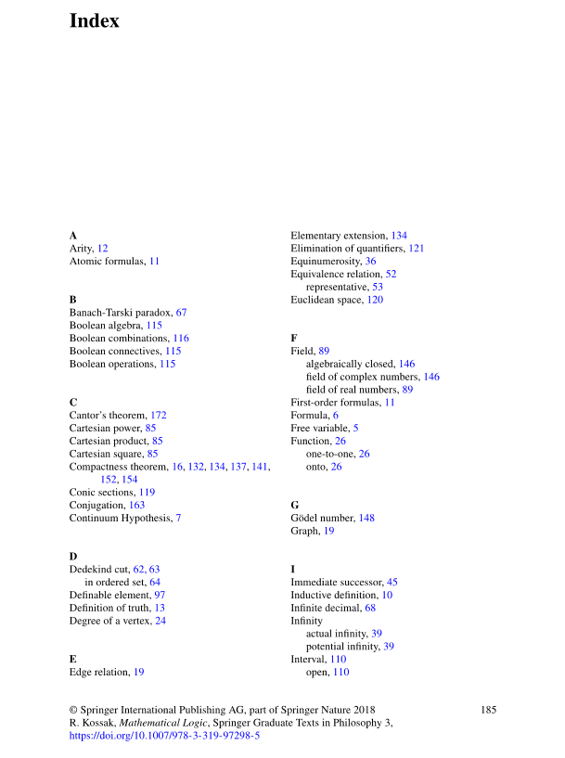
Main Obstacles Right Now
Determining where the Index in any given PDF is
Filtering and removal of non-relevant content (e.g. page number, header, etc)
How to identify subphrases
These are not individual entries but subentries
Header/Footer
Pagenumber
Automata and Computability [3]

Slide 8
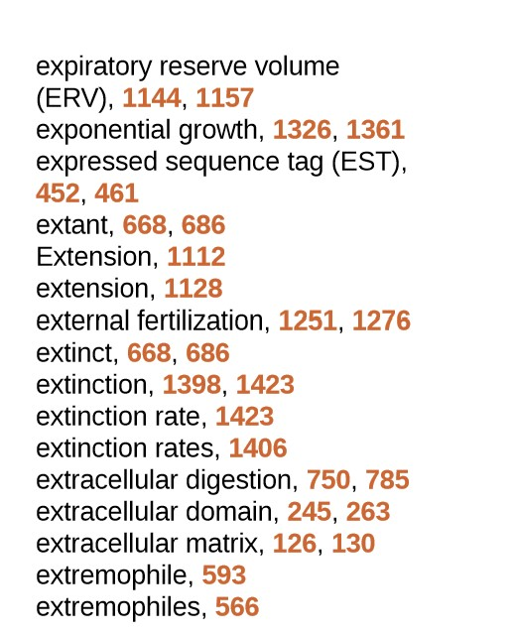
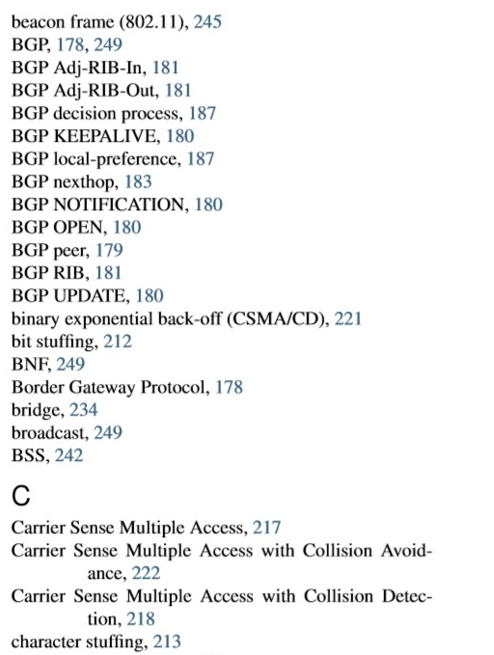
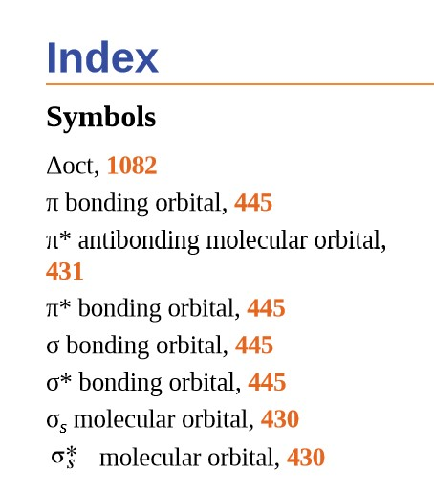
Examples of special cases
Some special symbols
The phrase is too long and split into two lines
How to distinguish between the hyphen existing in the phrase itself and the hyphen due to line breaks
phrase is too long
mathematics symbols
hyphens due to line breaks
Chemistry-OP [4]
Biology-OP[5]
Computer-Networking-Principles-Bonaventure-1-30-31-OTC1 [6]

Slide 9
Sources
[1] Corbett, P. S., Volker, J., Lund, J. M., Pfannestiel, T., Vickery, P. S., & Janssen, V. (2014). U. S. History. Amsterdam, Niederlande: Amsterdam University Press.
[2] Koo Ping Shung, (Mar 15, 2018) Accuracy, Precision, Recall or F1? https://towardsdatascience.com/accuracy-precision-recall-or-f1-331fb37c5cb9
[3] Kozen, D. C. (2013). Automata and Computability. New York, Vereinigte Staaten: Springer Publishing.
[4] Flowers, P., Theopold, K., Langley, R., STEPHEN F., ROBINSON, W. R. (2015). Chemistry-OP. Rice University Press
[5] RYE, C., WISE, R., JURUKOVSKI, V., DESAIX, J., CHOI, J., AVISSAR, Y. (2013). Biology-OP. Rice University Press
[6] Olivier Bonaventure (October 30, 2011) Computer-Networking-Principles-Bonaventure-1-30-31-OTC1.

